Slide 1
























input GT efficientderain efficientderain+ RCDNet RCDNet+
29.60/0.9261 32.16/0.9555 32.21/0.9564 38.16/0.9863
DDN数据集
30.03/0.9125 31.44/0.9387 31.46/0.9390 36.93/0.9689
31.13/0.8635 32.73/0.9103 32.81/0.9116 38.12/0.9683
27.19/0.9372 28.10/0.9572 28.11/0.9573 32.57/0.9684

Slide 2
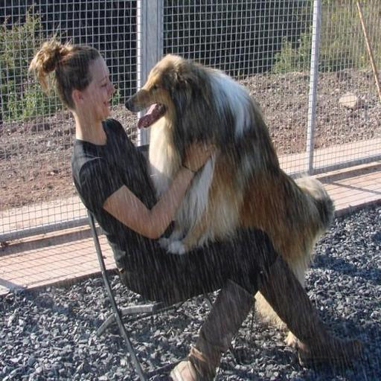

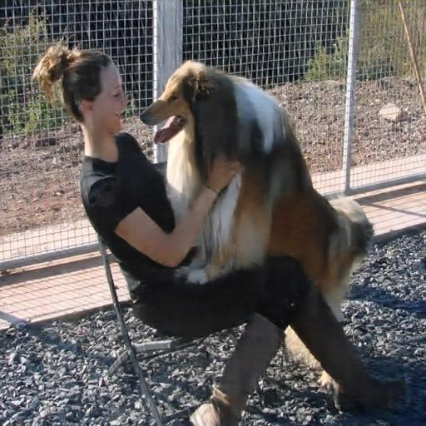

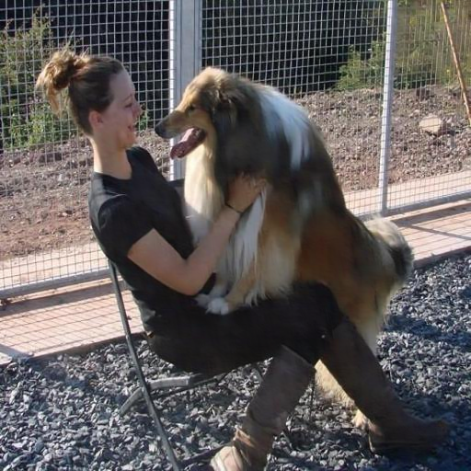







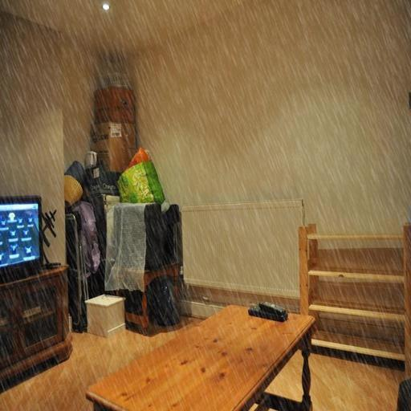
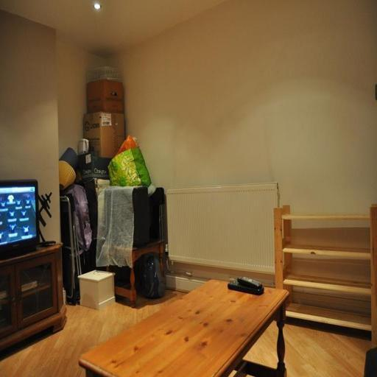
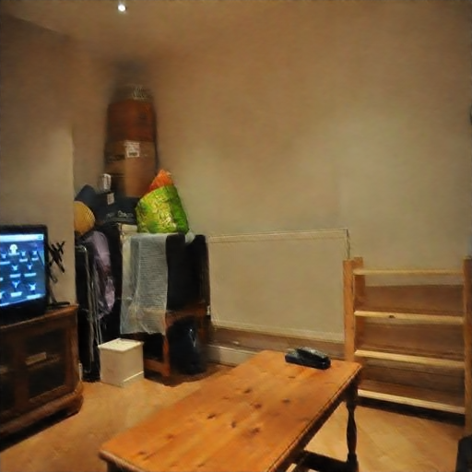



input GT efficientderain efficientderain+ RCDNet RCDNet+
DID数据集
27.80/0.9237 29.42/0.9426 30.84/0.9705 34.83/0.9795
33.25/0.9478 39.25/0.9788 39.81/0.9786 43.21/0.9885
35.18/0.9616 37.27/0.9756 37.56/0.9696 40.28/0.9851

Slide 3
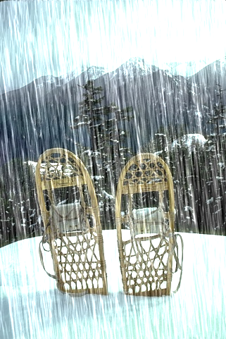
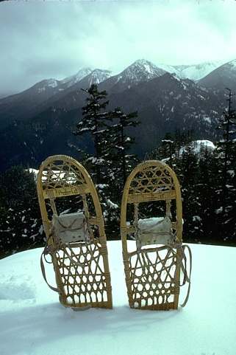
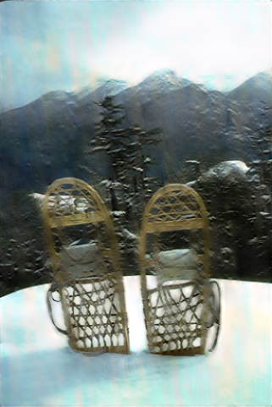
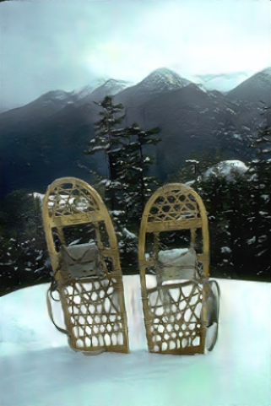
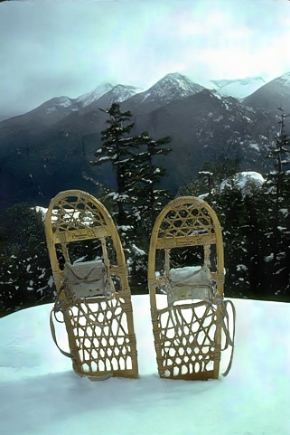
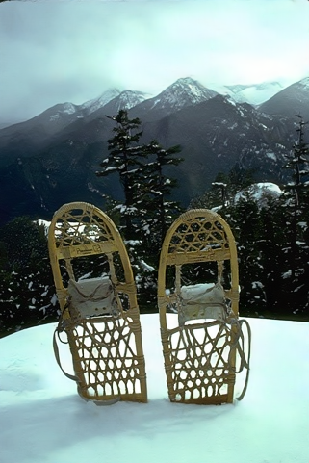







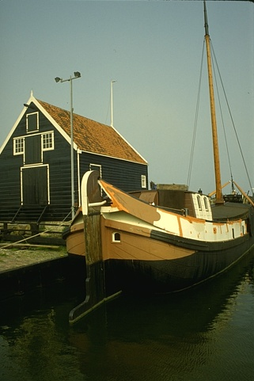

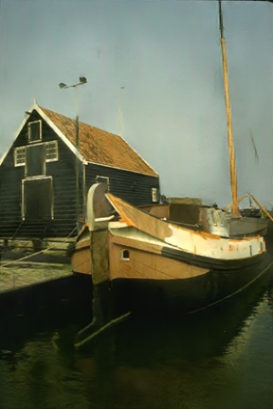


input GT efficientderain efficientderain+ RCDNet RCDNet+
R200H数据集
21.90/0.8042 23.57/0.8521 28.14/0.9320 31.90/0.9484
23.00/0.7950 26.09/0.8453 28.60/0.9204 31.96/0.9384
23.88/0.7950 26.03/08799 31.87/0.9453 35.10/0.9613

Slide 4


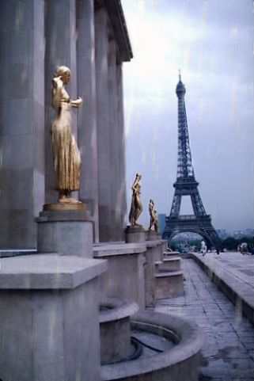

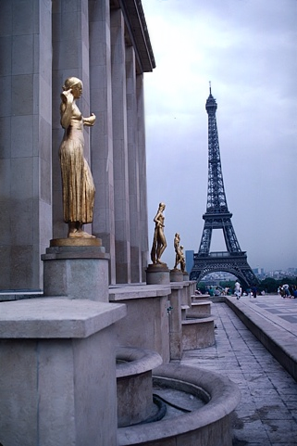


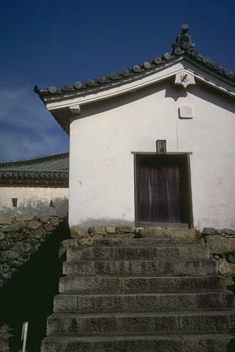
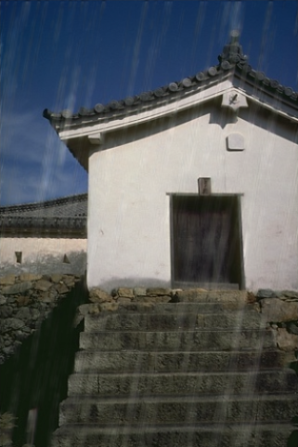
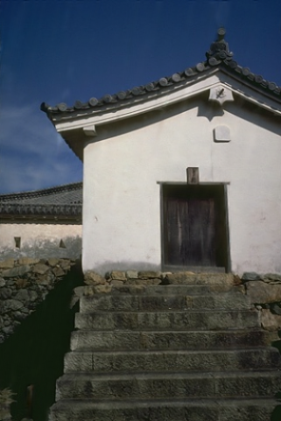
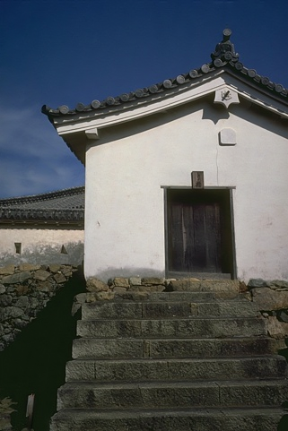







input GT efficientderain efficientderain+ RCDNet RCDNet+
R200L数据集
29.00/0.8859 29.68/0.9070 36.20/0.9783 40.40/0.9877
30.79/0.8975 32.57/0.9327 37.84/0.9844 41.87/0.9882
29.95/0.9377 31.68/0.9560 38.94/0.9928 42.31/0.9948

Slide 5
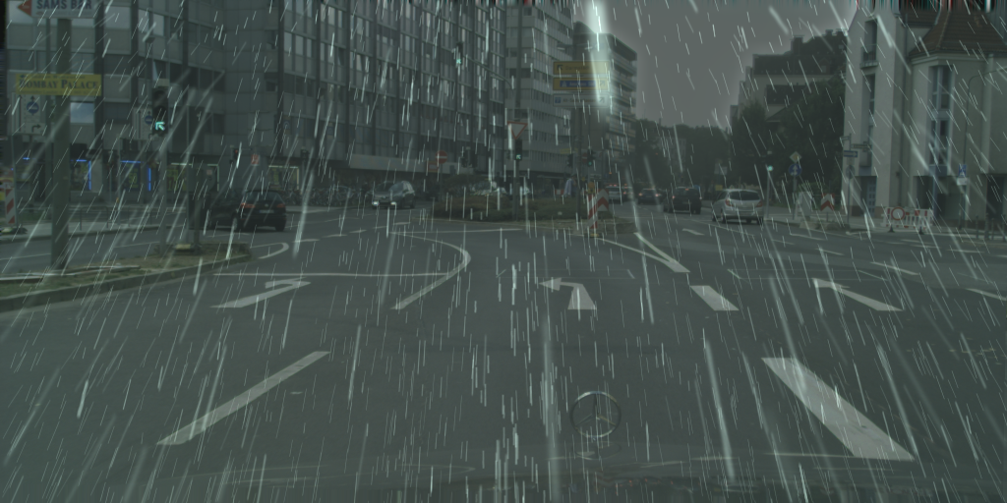
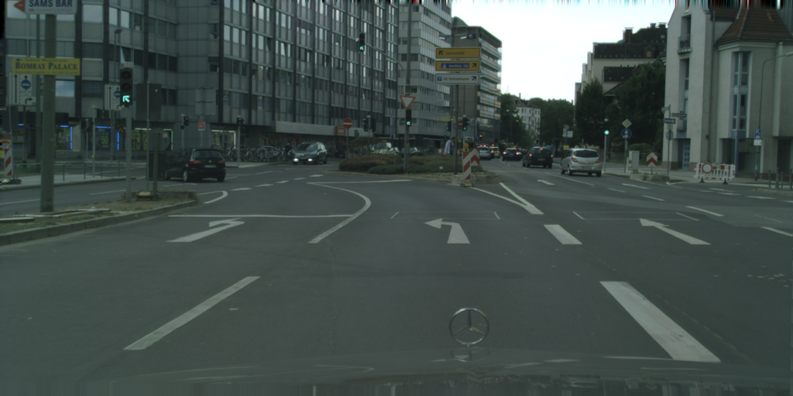
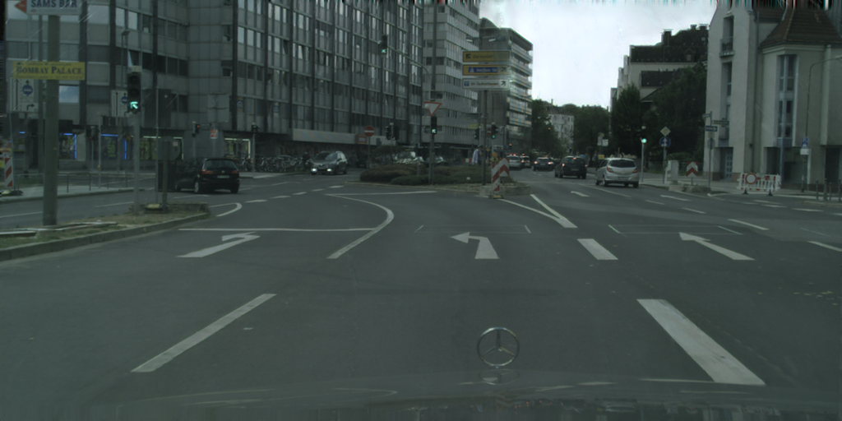
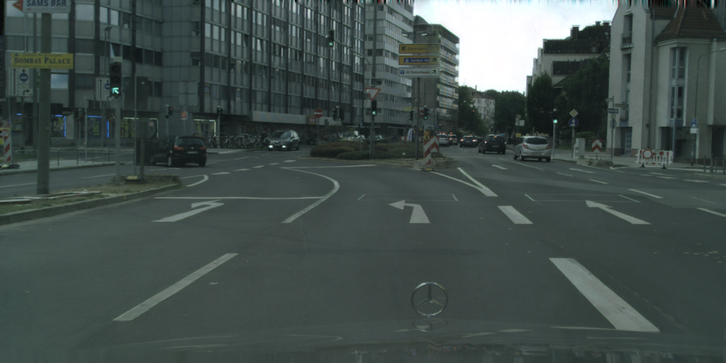
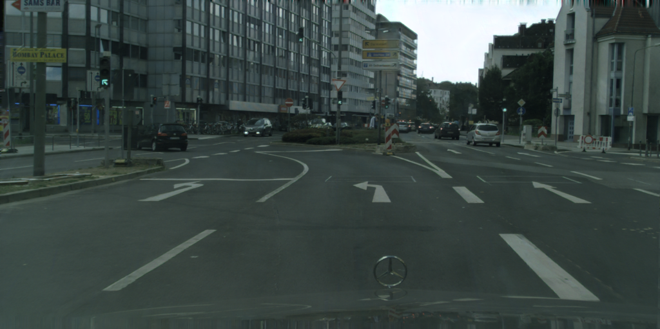
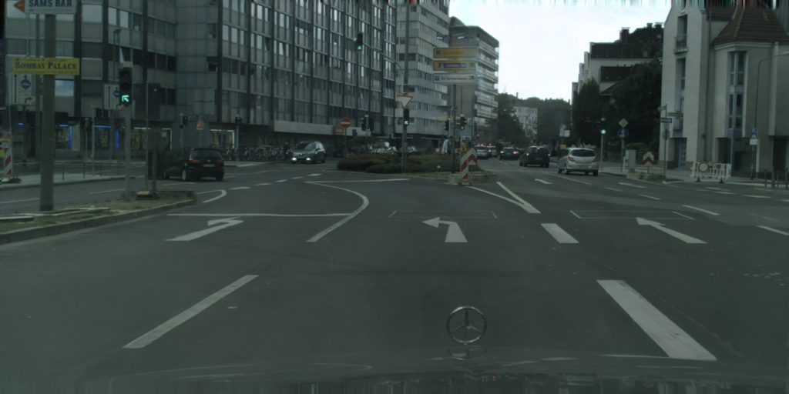
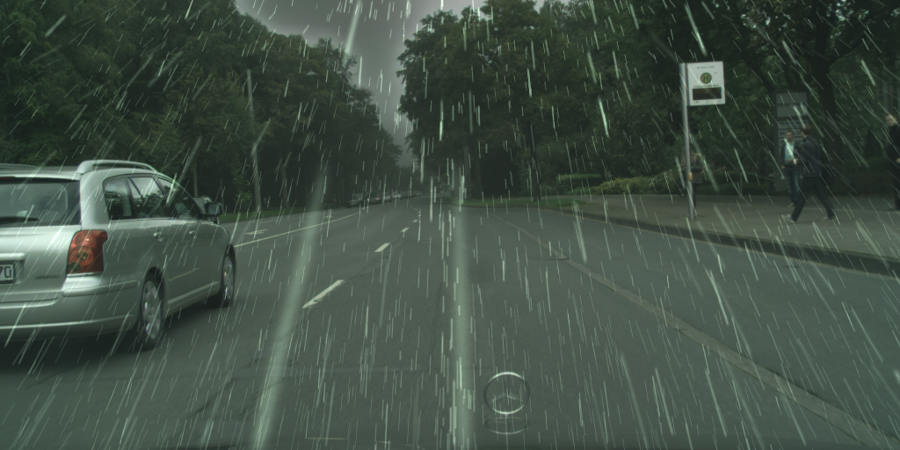
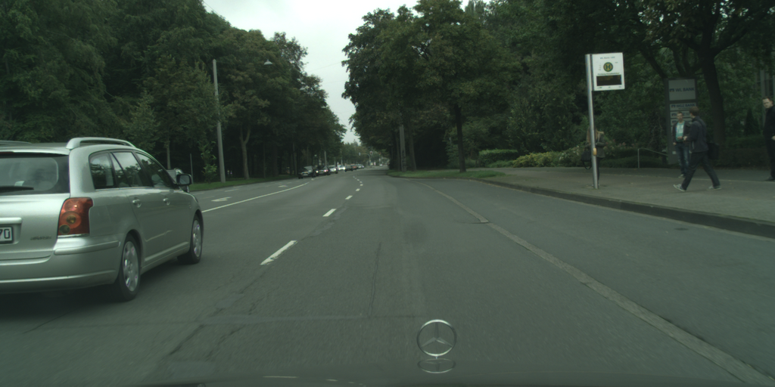
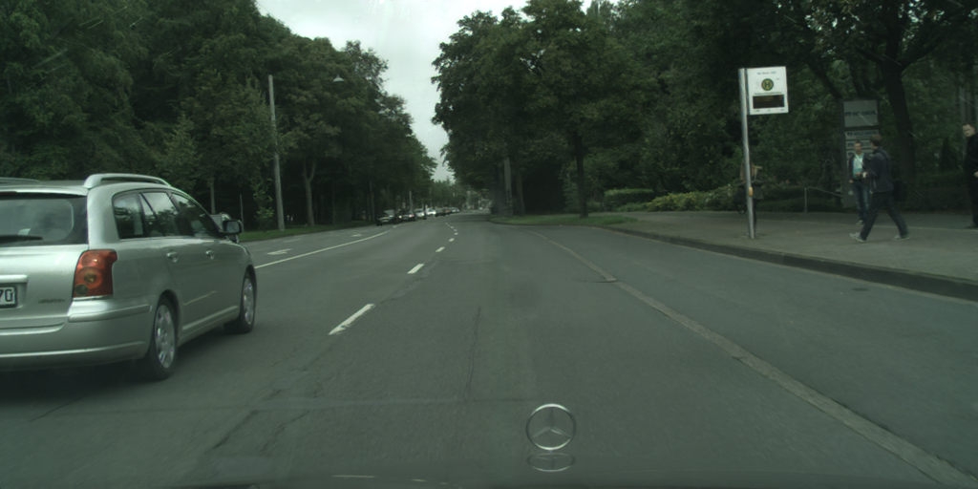
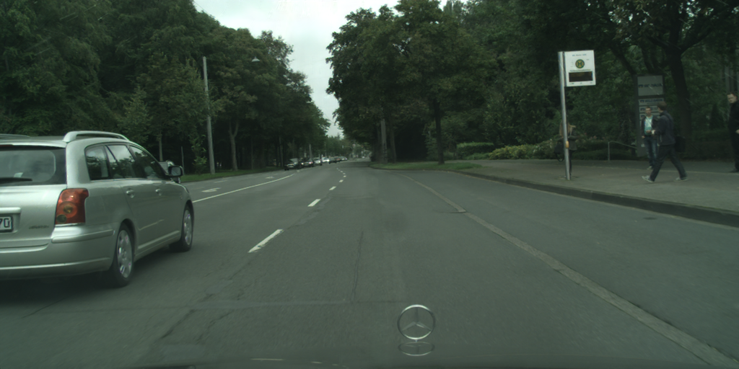
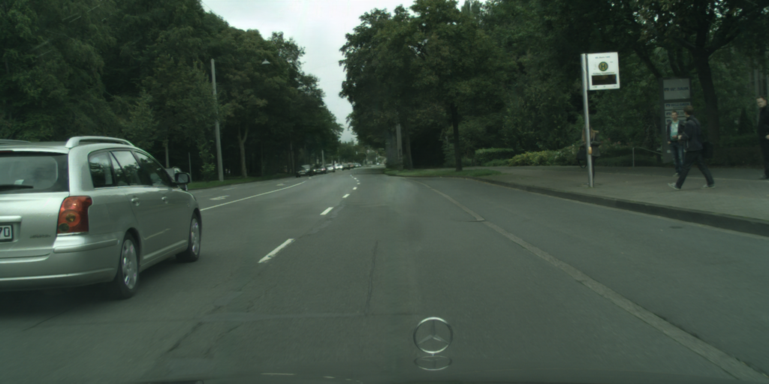

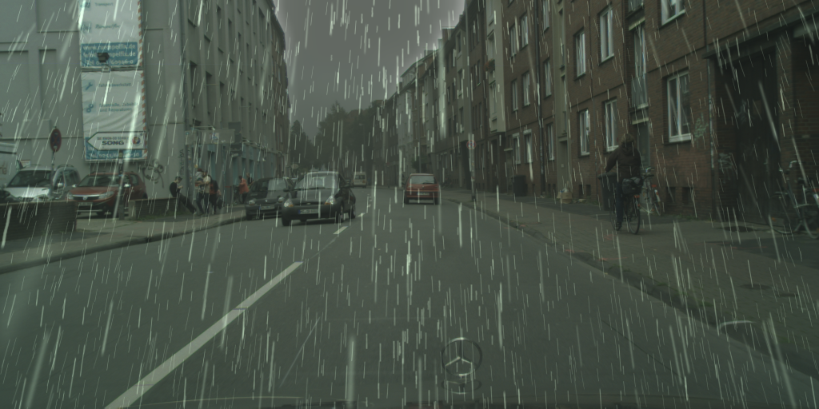
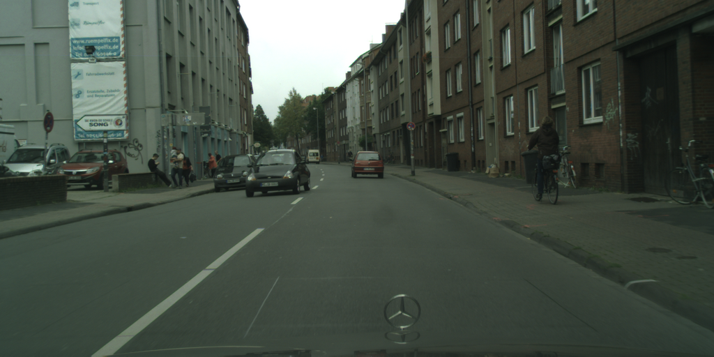
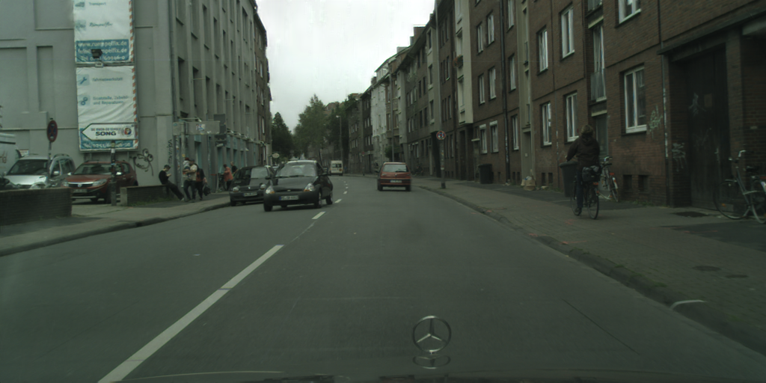
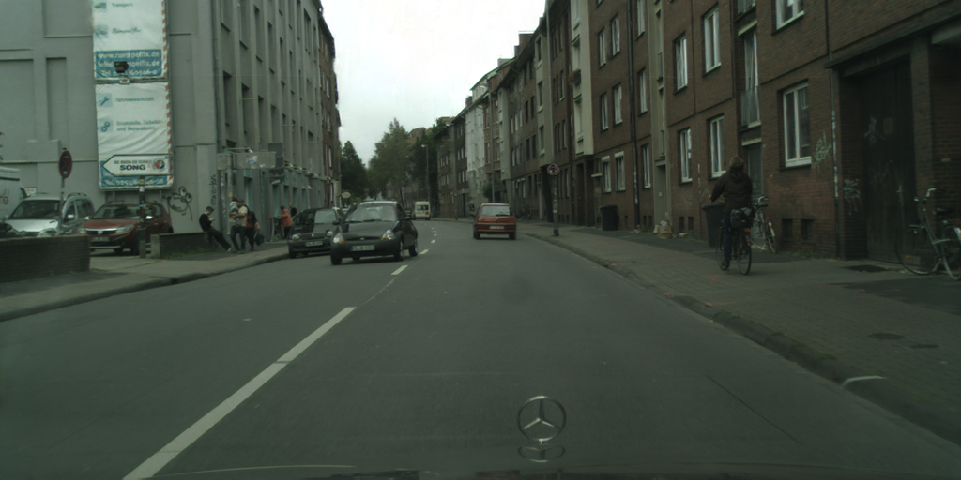


input GT efficientderain efficientderain+ RCDNet RCDNet+
cityscape100数据集
34.05/0.9881 37.36/0.9920 29.83/0.9797 30.57/0.9821
38.30/0.9905 41.11/0.9930 35.70/0.9877 37.62/0.9894
37.00/0.9899 39.58/0.9917 35.23/0.9864 36.78/0.9884

Slide 6

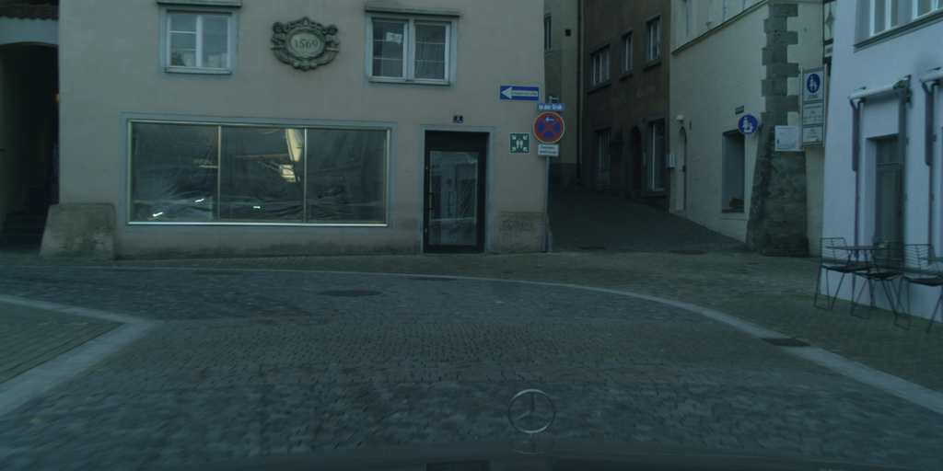



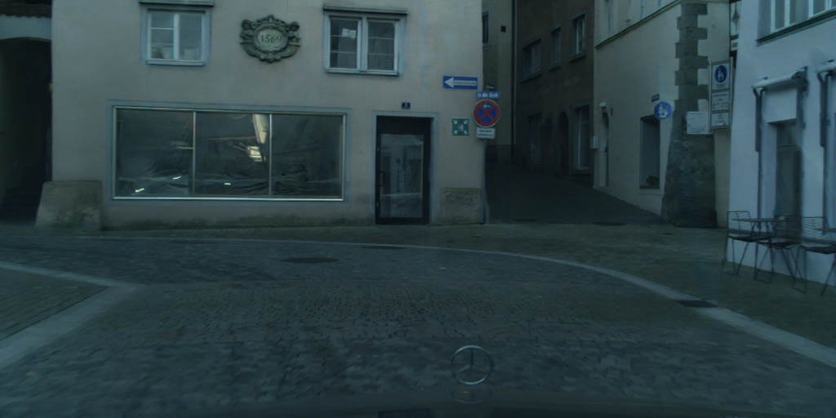


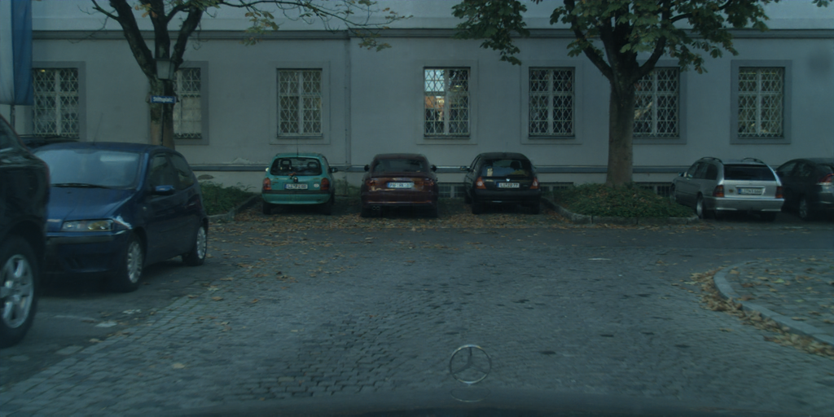

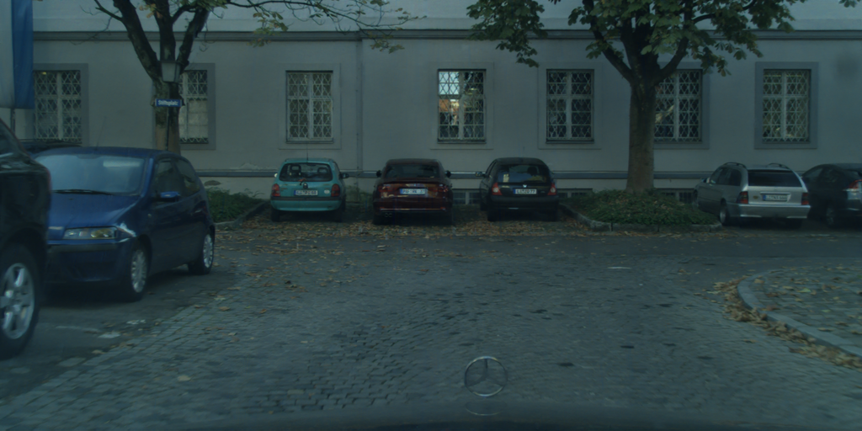
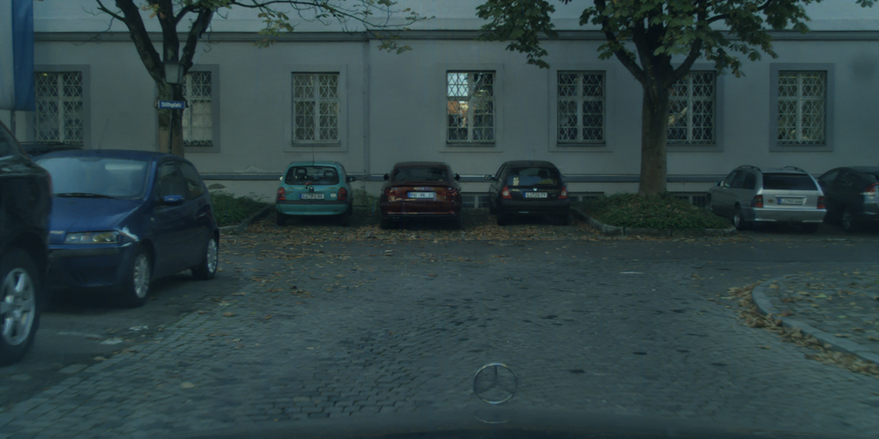






input GT efficientderain efficientderain+ RCDNet RCDNet+
cityscape200数据集
33.82/0.9850 37.64/0.9887 29.47/0.9709 30.93/0.9753
36.21/0.9881 39.19/0.9900 31.25/0.9781 31.69/0.9796
35.75/0.9900 38.69/0.9916 33.86/0.9807 35.36/0.9838

